Slide 1

ARIMA Sales Forecasting Case Study – Group 4
2019
TCS Hackathon
November 13, 2019
TCS Internal

Slide 2

ARIMA CASE STUDY
OBJECTIVE:
To create a sales forecasting tool using ARIMA model for a multinational retail corporation.
ASSUMPTIONS:
The user should be able to select the corresponding channel, he wants to forecast.
• The user should be able to define, how many weeks of historical data he wants to consider and corresponding start date for historical data.
• The user should be able to define, how many weeks forecasting he wants to do it and corresponding start date for future forecasting.
• Each entity should’ve 4 weeks of history and 4 weeks of future loaded by default
• The user should be able to fetch data on scroll greater than 4 weeks for both history and future
• Forecast monthly summary is required is required, by consolidating weekly data.
• The attributes based on channel and product should be dynamically loaded from tables.

Slide 3





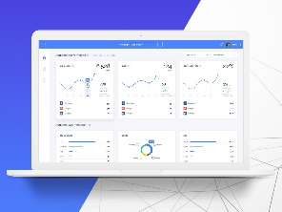


ARIMA Sales Forecasting – Architecture & Technology Stack
User Interface
Server Layer
ARIMA Service
History and Forecasting Start Dates
Forecasting Y/N - Flag,
History Data for Prediction,
Forecast data
History and Forecast Data,
Update Forecast
Data
History and
Forecast data
TCS Internal

Slide 4
Request – Response Details
UI Request to server API | Server API Response | Input to ARIMA service | ARIMA service response
Start date Number of weeks Channel | Start date End date History data

Slide 5
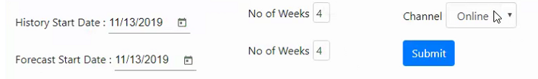

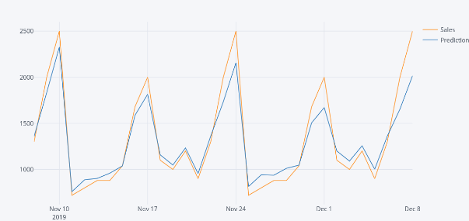
ARIMA Sales Forecasting – Process Flow
In UI , the user requests forecasting by selecting the history dates, the dates which user would like to view and the number of weeks
The channel could be online, instore or phone
By clicking on submit an api call is made by passing this data to the server.
User Interface
Server is core engine between UI and ARIMA service
UI calls Node server API with input data
Connects to mongodb and fetches history data
Based on history data, calls ARIMA service API
Receives forecasting data from ARIMA service
Send back the Forecasting data to UI for user
Server
NodeJS
REST API
Visualize and stationarize the time series
ARIMA Service
Plot ACF charts and find parameters
Forecasting
Build the ARIMA model
REST API
Train and test the model
First order auto regressive model
Make Predictions
TCS Internal

Slide 6
Thank You
2019
TCS Hackathon
November 13, 2019
TCS Internal

